Slide 1
Features of Information Retrieval Systems
Dr. Vinit Kumar

Slide 2
IRS
Based on the accessibility of the system, the IRS can be categorised in two broad categories.
In-house developed
In-house information retrieval systems are set up by a particular library or information centre to serve mainly the users within the organization.
External or Subscribed
those IRSs that are set up outside the library for providing content to a variety of users.
These are mostly commercially available from vendors.
Libraries either freely access these IRSs or pay for the subscription.

Slide 3
These days, both category of IRSs are available either
Through vendor supplied storage device, such as PenDrive or CD ROM, or
Through online mode.
On the basis of above discussion, we will discuss following IRSs in detail.
OPAC
Electronic Databases
Institutional Repositories
Digital Libraries
Web Search Engines

Slide 4
Characteristics of an external IRS
users get access to remote databases that are often many in number and large in size;
many databases can be searched using a single search interface;
database records mainly contain bibliographic details of records with abstracts, and sometimes with additional information, such as citations, etc.; only some databases contain full text information;
service providers have their own search interface with good search and retrieval capabilities;
users need to register with the service providers;
users are charged for searching as well as for the content; and
modern online service providers have web interfaces with good search features and hyperlinked records/information.

Slide 5
Features of an IRS
Although each online search service provider, such as Dialog, Ovid, STN, etc., has its own proprietary retrieval engine and user interface, the commonly available search and retrieval features are as follows [Chowdhury and Chowdhury, 2001a]:
Users can select one or more databases to search;
Novice and expert search modes are available;
A search can be conducted with one or more keywords or phrases;
Common search facilities include: Boolean search, truncation (some systems also allow users to search for the variant forms of a word), proximity search, and field search (number of fields that can be searched depends on the chosen database);
Searches can be limited by applying certain restrictions, such as language, date, type of material, etc.;
A search can be conducted for a range of period (date of publication, for example);
Some systems show the frequency of occurrence of the search terms in the output;
Dialog provides a unique facility of searching through a common index file that allows users to select databases appropriate for a search topic;
Some systems provide access to thesauri through the search interfaces; and
Search results can be sorted and sometimes ranked by selected criteria.

Slide 6
Information Retrieval Features of OPACs
Browse and search facilities;
Keyword and phrase search facilities;
Indexers assign subject headings to the records by using a subject heading list like
LCSH (Library of Congress Subject Heading List), and users can search by these assigned subject headings;
Boolean search usually limited to the keyword search option; in other words, only keywords can be combined with Boolean operators;
Proximity search also limited to the keyword search option;
Search results are usually not ranked;
Searching of records through selected keys – author, title, ISBN, call number, etc.; these are searched as phrases, and are usually automatically right truncated; and
Some searches can be limited by date, collection, language, etc.

Slide 7
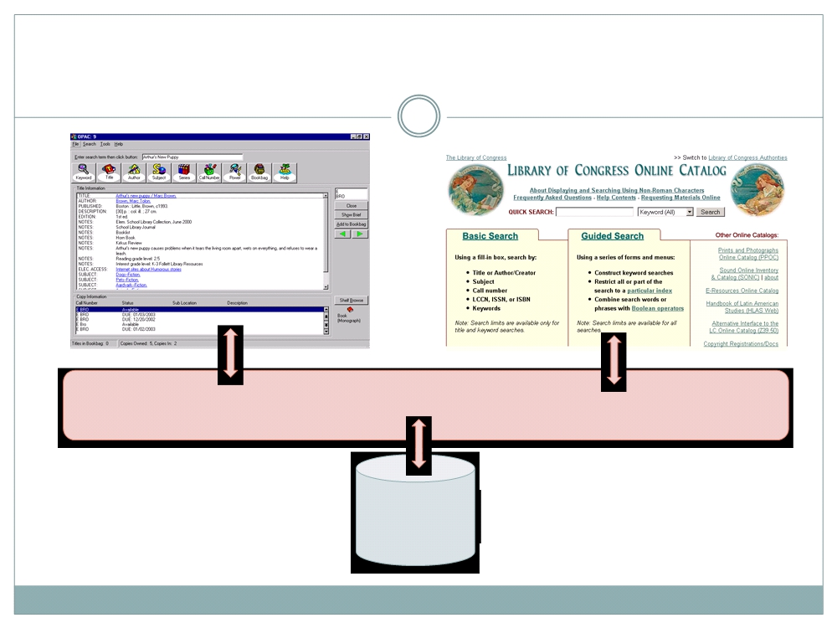
Traditional (Web)OPAC
(Web)Server Application
ILS Database
(Bibs)

Slide 8
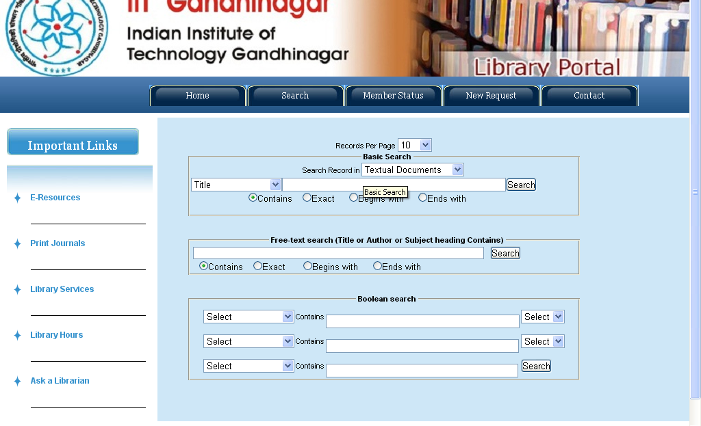

Slide 9
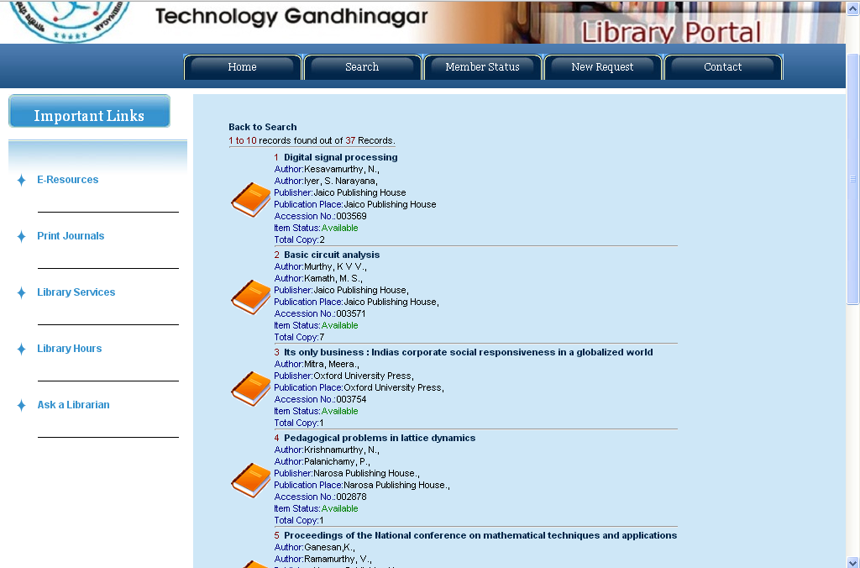

Slide 10
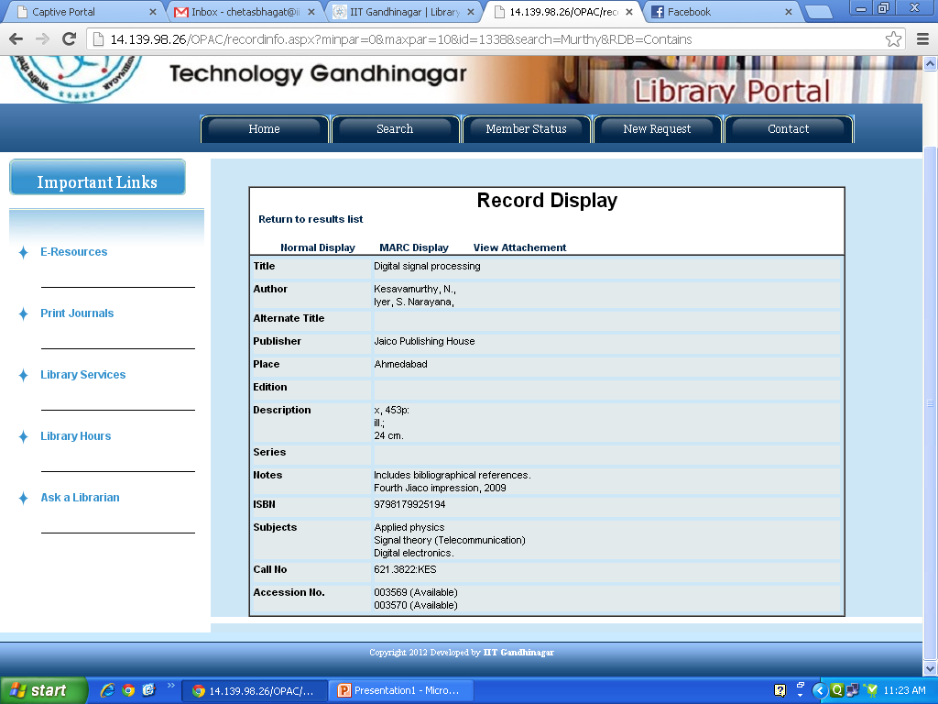

Slide 11
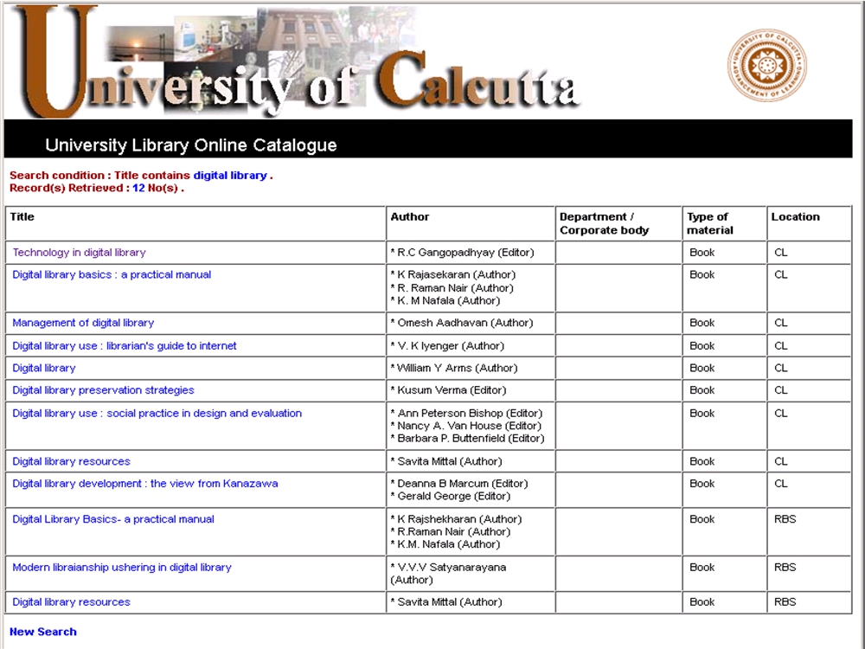

Slide 12

Traditional (Web)OPAC
 Keyword search!
 Uses database queries
○ Author, title, subject ○ ISBN/LCCN search ○ Boolean queries
○ „LIKE‟ statements ○ Exact/partial match
○ Limited use of search
○ Proximity search
algorithm
 Browse index
 poor relevance ranking  Only physical collection and e-books
○ Authority headings ○ Title, Call Number
 Real-time item status!
○ Copies & availability info

Slide 13
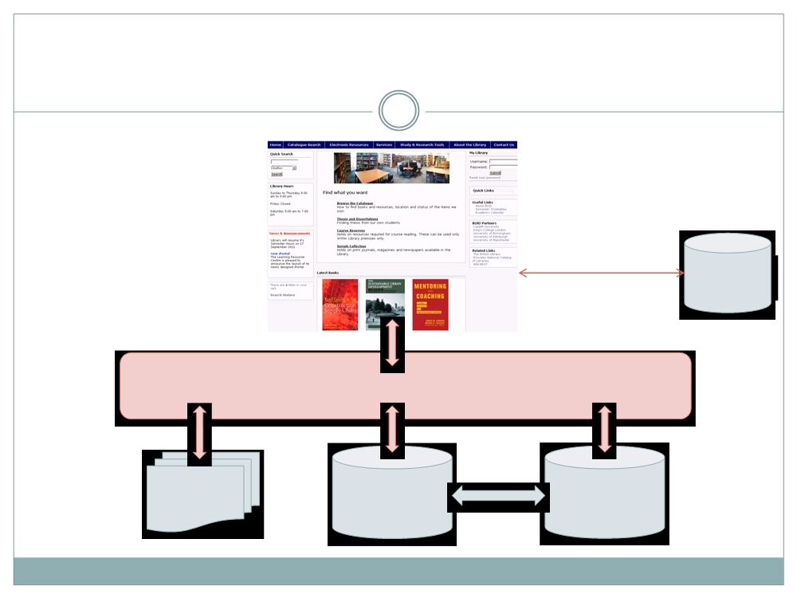
Integrated OPAC Portal
Enrichment
Web services
Services
Web Server Application
Website
ILS Database
ILS Database
content
(Bibs)
(Patrons)

Slide 14
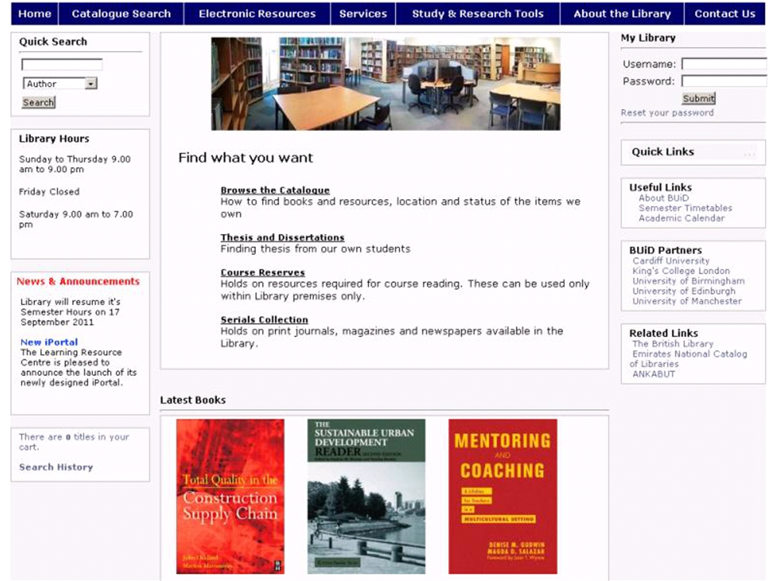

Slide 15
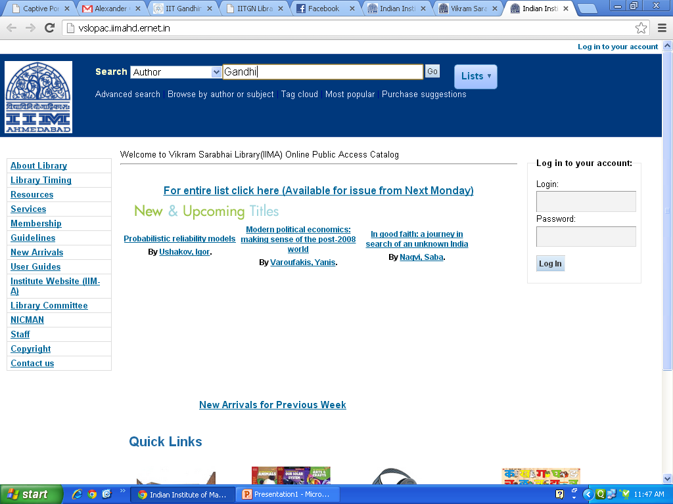

Slide 16
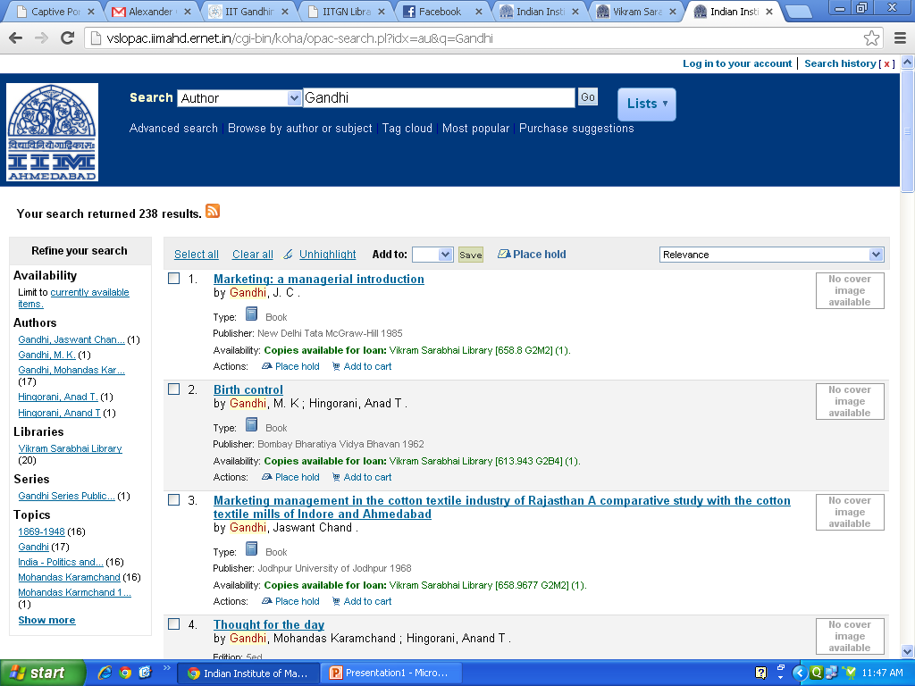

Slide 17
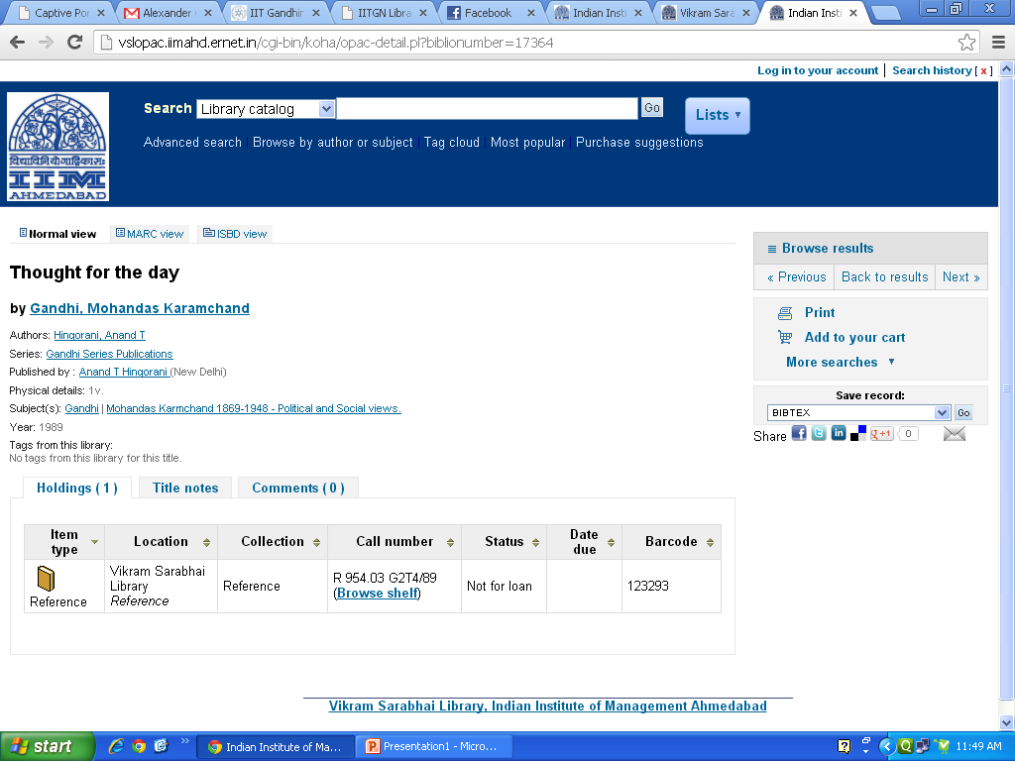

Slide 18
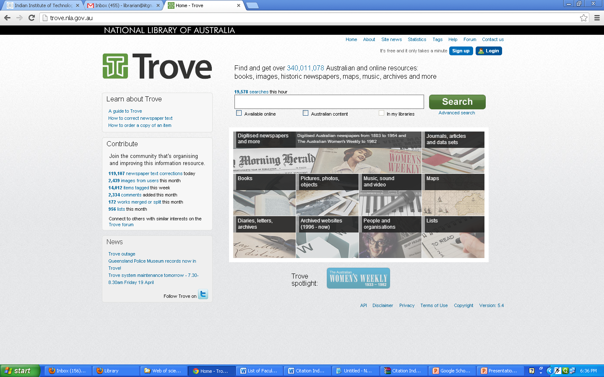

Slide 19
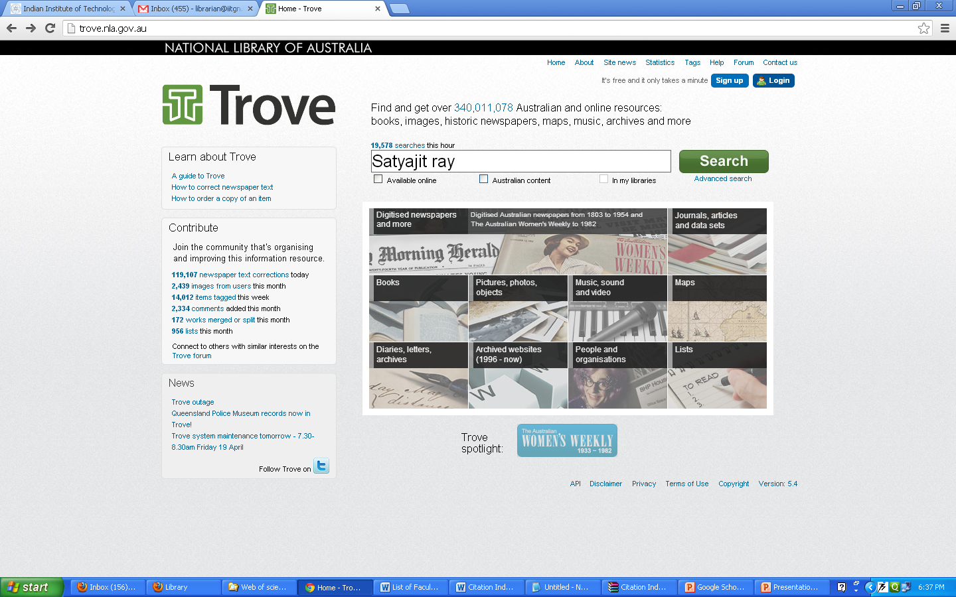

Slide 20
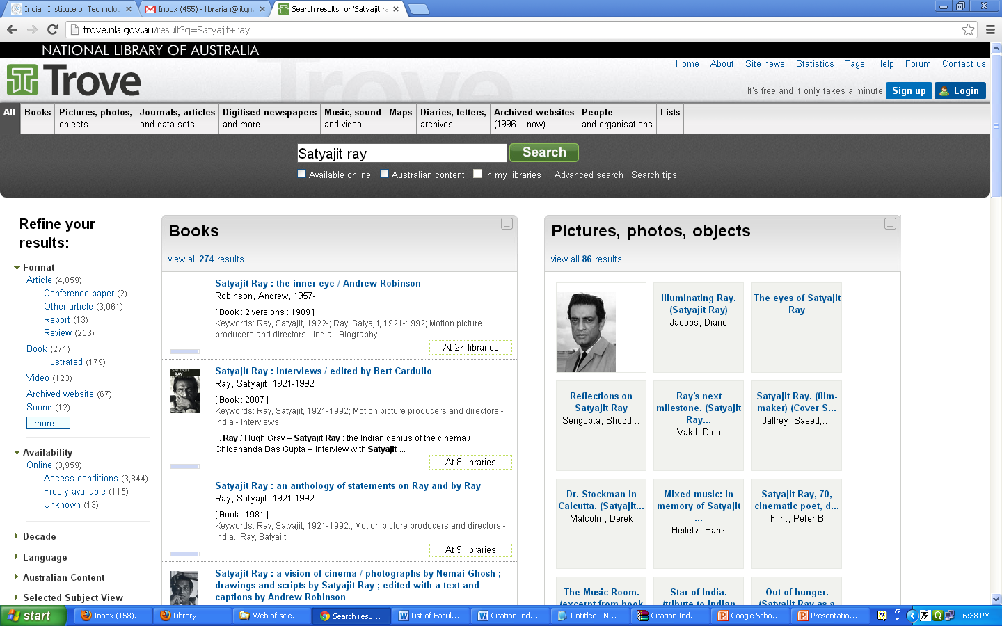

Slide 21
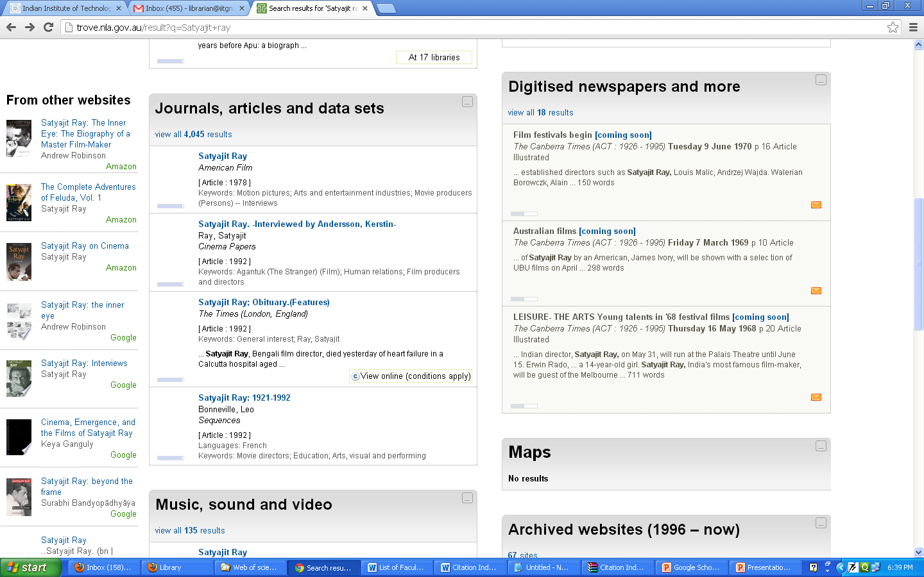

Slide 22
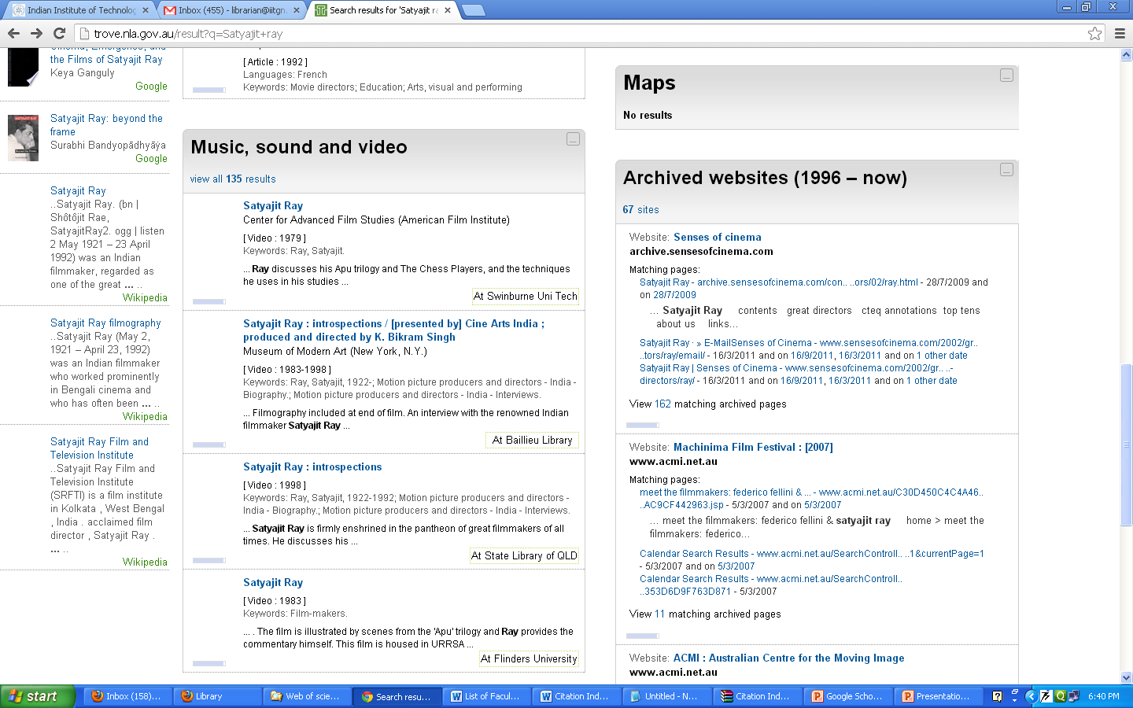

Slide 23
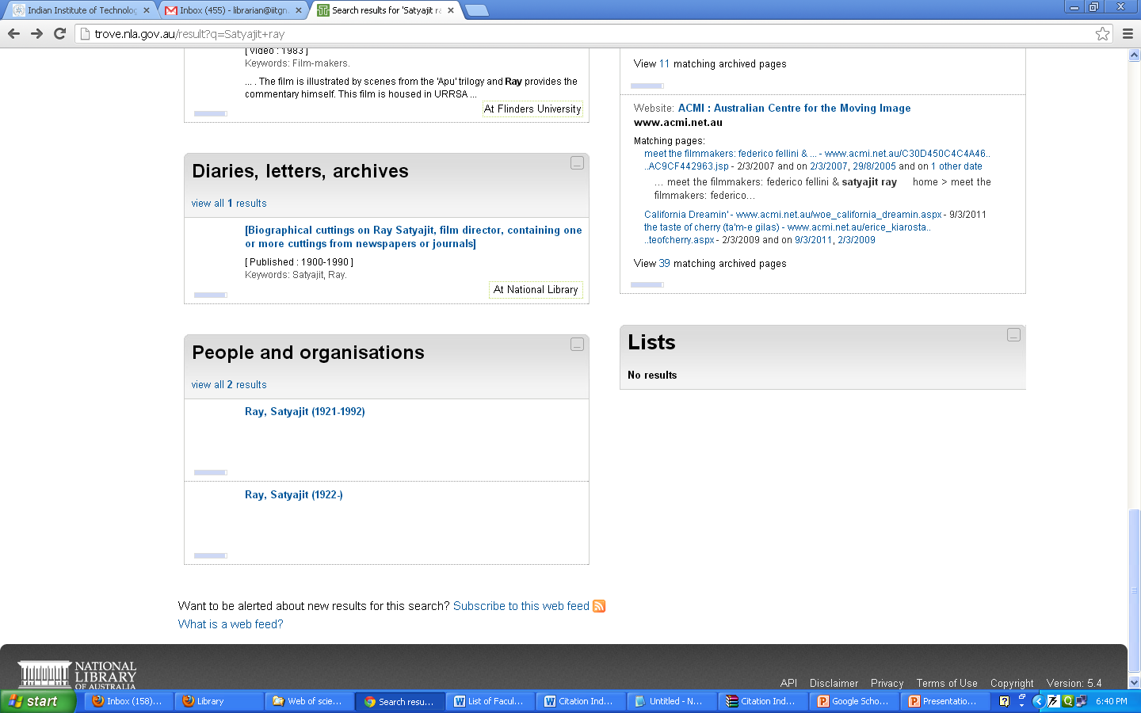

Slide 24
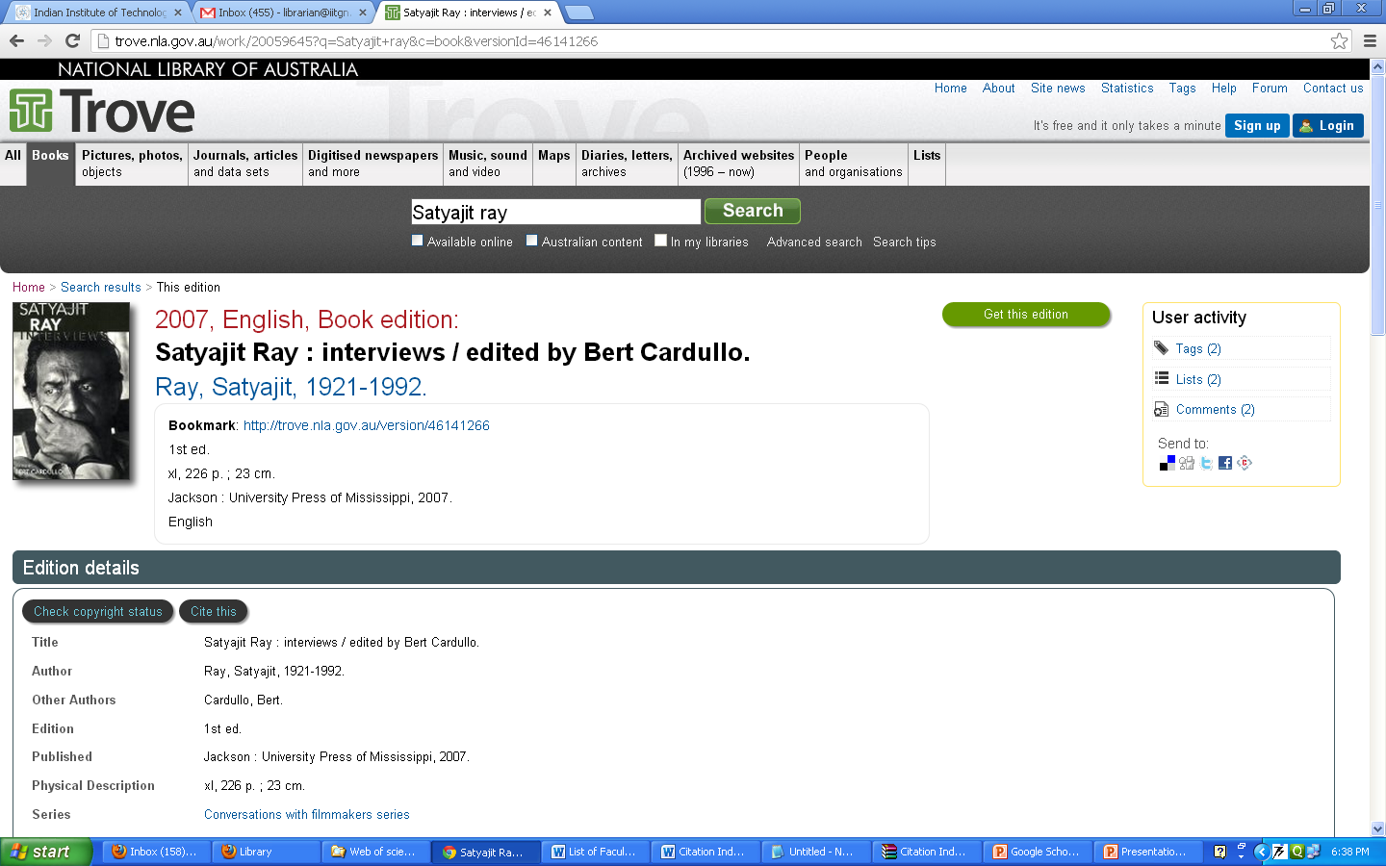

Slide 25
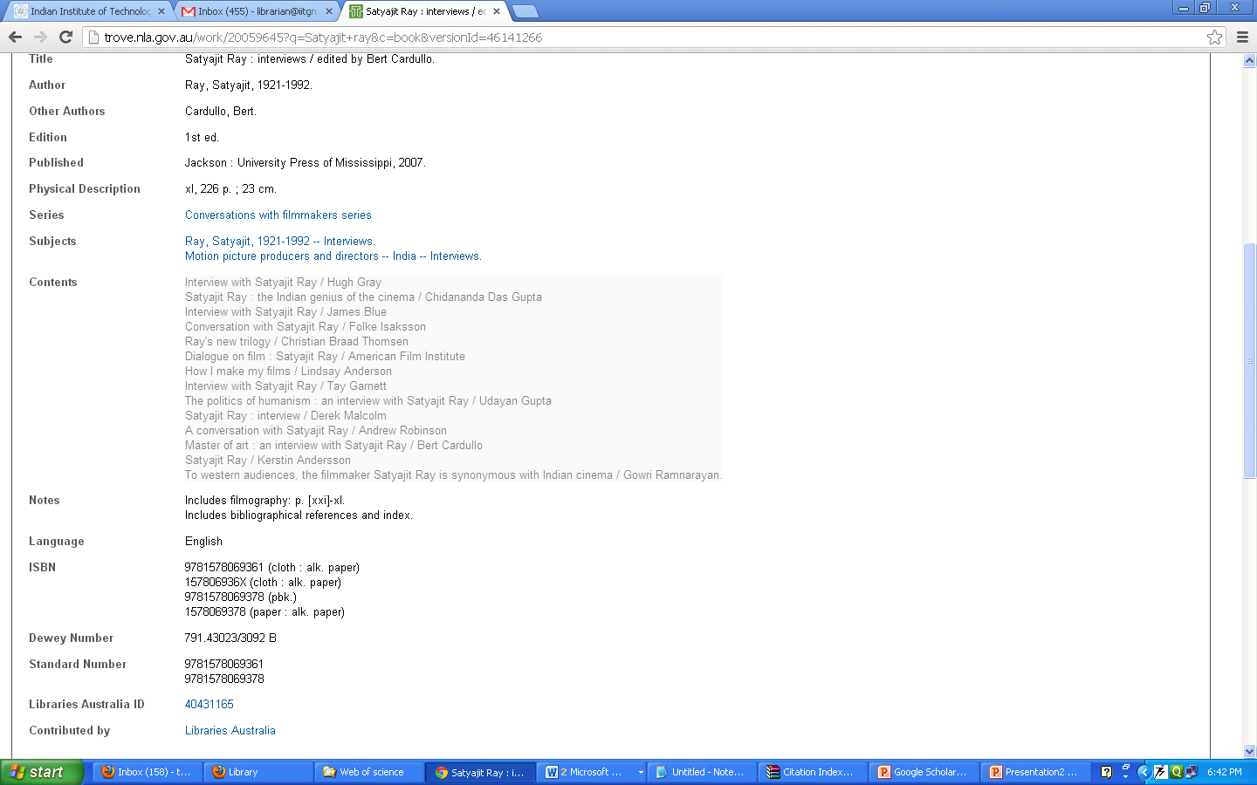

Slide 26
